Slide 1
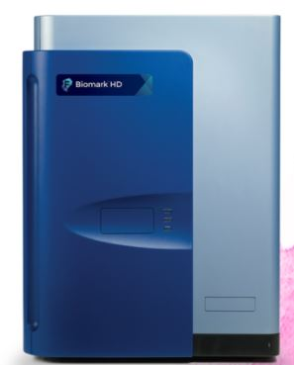
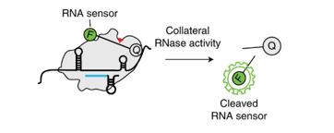
CARMEN, CARMEN, CARMEN, Chameleon
Marie Kirby
Genomics and Diagnostics Team
Branch Meeting 01/19/22

Slide 2
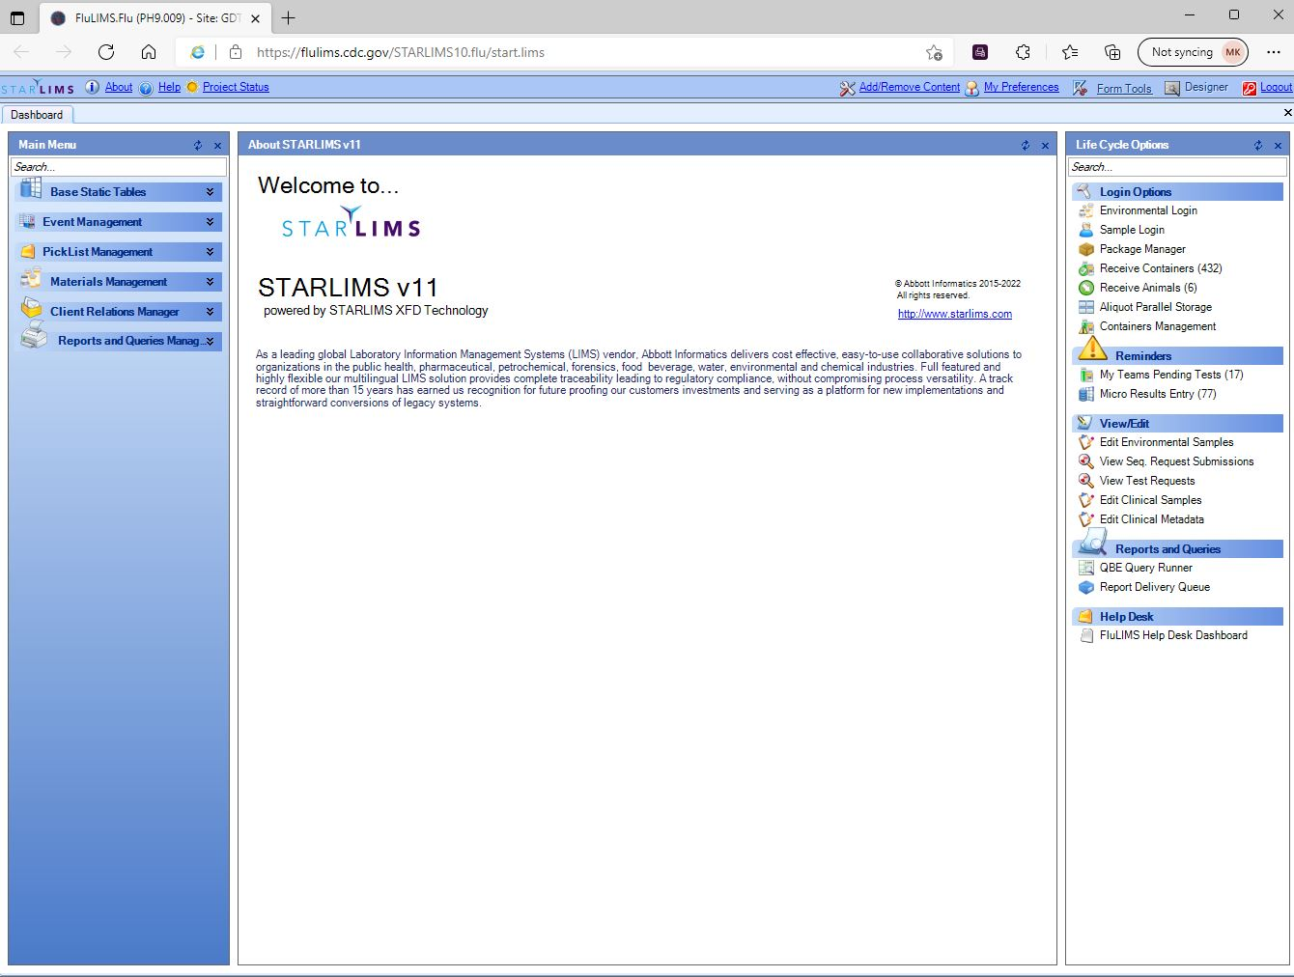
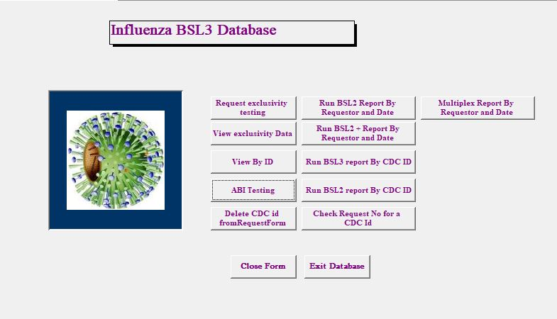
FluLIMS Testing Transition

Slide 3
Exclusivity and Surveillance Testing Updates
Exclusivity and Surveillance testing has transitioned from the BSL3 Integrity/Diagnostic Database over to FluLIMS
Major improvement to workflow = benefits for all
Still a work in progress:
Building pieces to improve final interpretations of reassortant viruses
Building in requests for Sera work
Optimizing/Debugging
Bugs happen – please remain vigilant – but overall – transition has gone very smoothly thus far
Goal for this year: Transitioning non-CLIA/International Diagnostics reporting over

Slide 4
Nucleic Acid Detection with CRISPR Technology and CRISPR-based Diagnostics

Slide 5
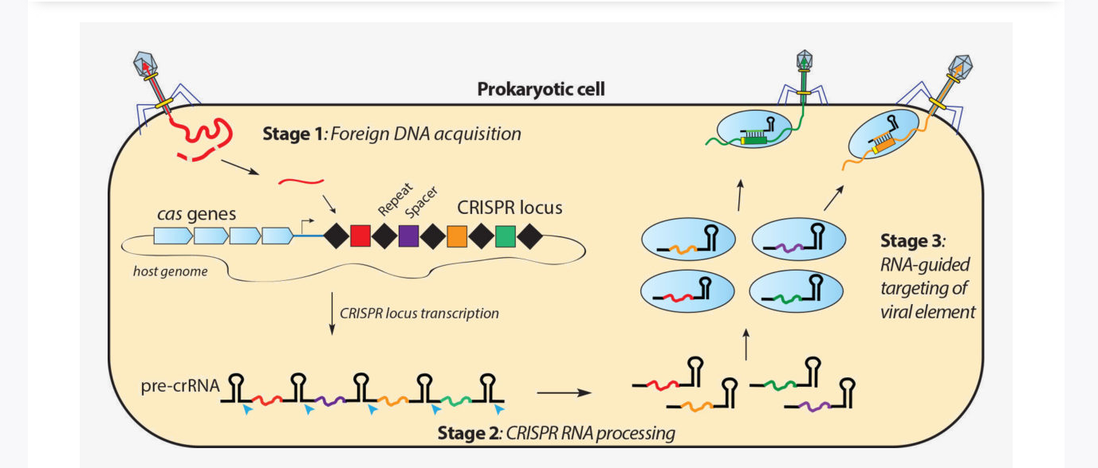
What is CRISPR?
Microbial Clustered Regularly Interspaced Short Palindromic Repeats
Adaptive immunity against foreign genetic material
Complex with CRISPR-associated (Cas) effector proteins (nucleases)
Image from: http://doudnalab.org/research_areas/crispr-systems/

Slide 6
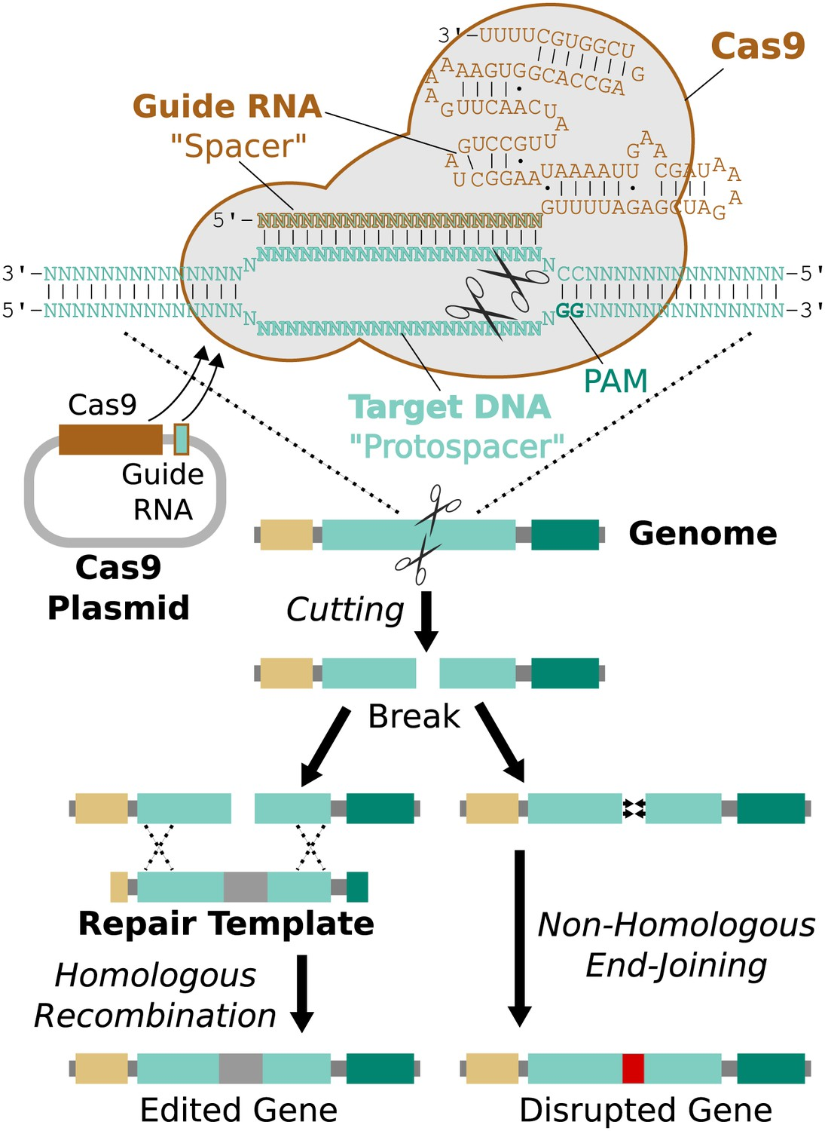
Genetic engineering with CRISPR/Cas9
Cas9 cuts DNA when activated
Image from: Esvelt et al. eLife 2014;3:e03401

Slide 7
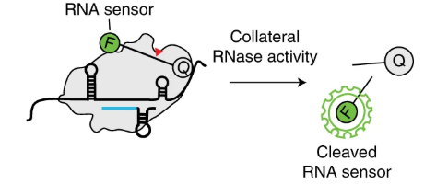
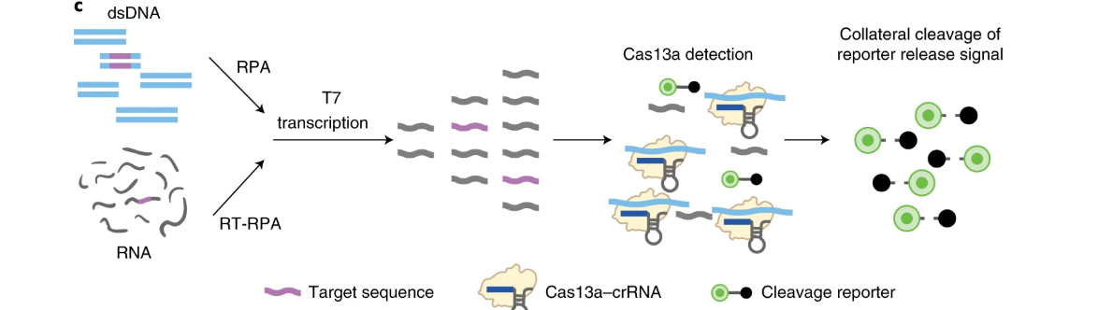
Specific High-Sensitivity Enzymatic Reporter UnLOCKing (SHERLOCK)
Cas13 = RNA-guided RNase – finds and cleaves ssRNA targets via guide RNA/Cas13 complex. Exhibits target-dependent promiscuous RNase activity (collateral activity) in which Cas13, upon binding to target sequence, also cleaves bystander RNA molecules
Isothermal amplification
Allows for multiplexed, portable, and sensitive detection of RNA or DNA from clinically relevant samples
Figure From: Kellner et al. Nature protocols 2019;14:2986-3012.

Slide 8
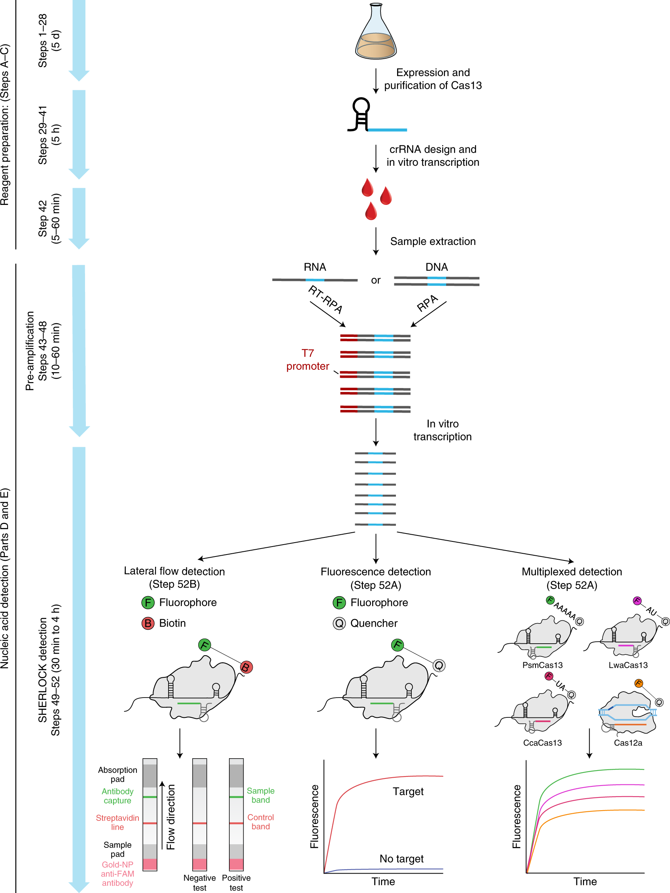
SHERLOCK
Figure From: Kellner et al. Nature protocols 2019;14:2986-3012.

Slide 9
Advantages and Limitations
SHERLOCK allows single-nucleotide mismatch distinction in target sequences – Cas13 does not catalytically activate when there are two or more mismatches in the crRNA:target duplex – so similar virus sequences can be easily distinguished
Testing is rapid - can have results in less than one hour
Testing can be multiplexed
Testing can be performed with limited on-site resources (=portable)
However – relatively low throughput – one sample/one tube measurement

Slide 10
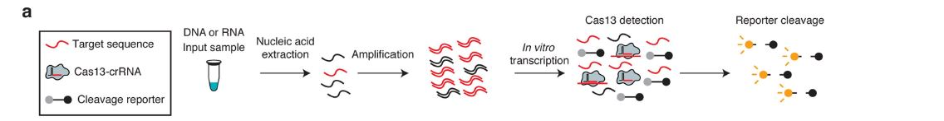
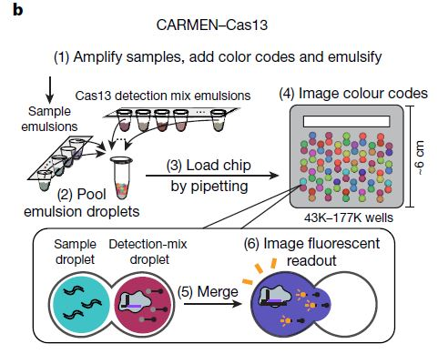
Massively multiplexed nucleic acid detection with Cas13
Combinatorial Arrayed Reactions for Multiplexed Evaluation of Nucleic Acids (CARMEN) = scalable multiplexed pathogen detection!
CARMEN Proof of Principal System was Developed at Broad Institute in Boston – Custom Chip Analyzed with Microscopy
Microwell-array system where input droplets organize themselves in the wells of the array, creating all possible combinations or Cas13-crRNA test with each sample
Fluorescent code for each sample and each Cas13-crRNA test shows which sample is being tested by which Cas13-crRNA test
Once these droplets combine, then fluorescence is read
Reduces amount of reagent needed and pipetting steps
Ackerman et al. Nature. 2020. Jun;582(7811):277-282. Epub 2020 Apr 29.

Slide 11
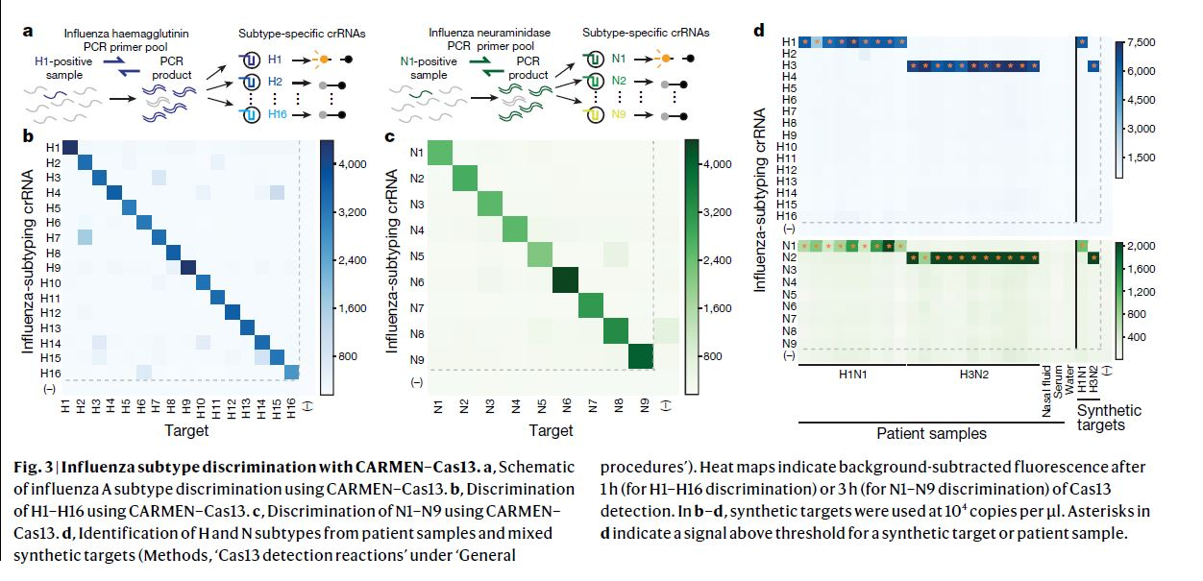
Influenza Haemagglutinin and Neuraminidase Detection as Proof of Principal
Ackerman et al. Nature. 2020. Jun;582(7811):277-282. Epub 2020 Apr 29.

Slide 12
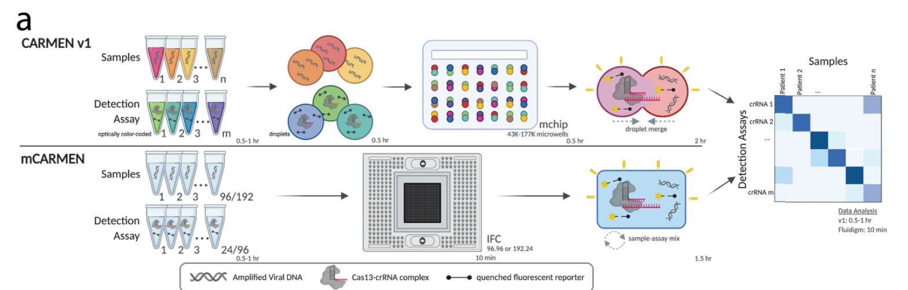
Update to microfluidic CARMEN (mCARMEN)
Welch et al. medRxiv. 2021. 12.14.21265689; doi: https://doi.org/10.1101/2021.12.14.21267689

Slide 13
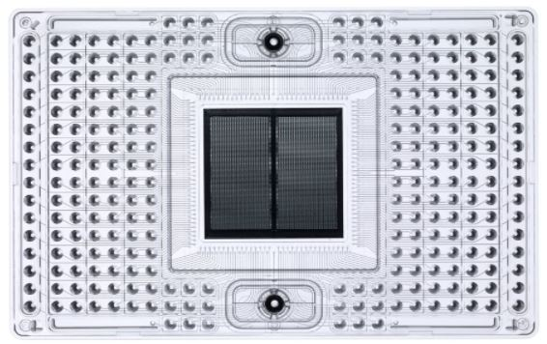
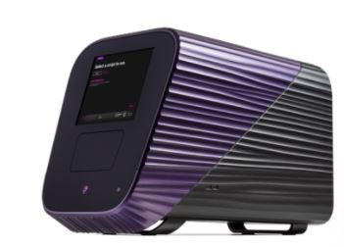
Biomark HD, IFC controller, and Chips
JUNO = IFC (integrated fluidic circuit) control = mixes samples and assays into the center panel of the chip via microfluidics
BioMark HD = reads the fluorescence/collects data
IFC chip – 192.24 = 192 samples and 24 assays tested
Green = Assay master mixes
Blue = Samples

Slide 14
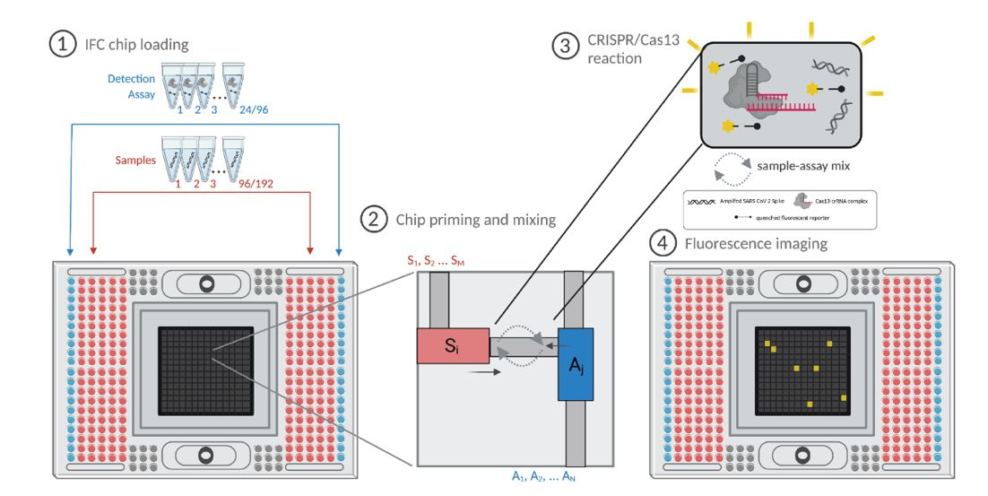
CARMEN-Fluidigm Workflow
Data from CARMEN can be used to detect pathogens or to distinguish variants

Slide 15
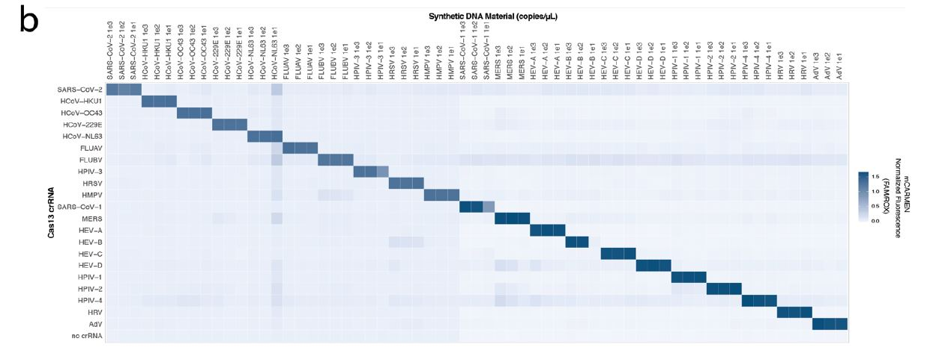
CARMEN can be used to detect Pathogens – e.g. – 21 Respiratory viral panel
Welch et al. medRxiv. 2021. 12.14.21265689; doi: https://doi.org/10.1101/2021.12.14.21267689

Slide 16
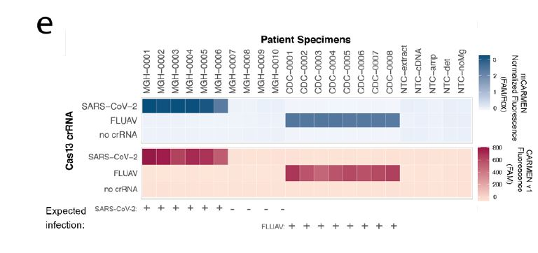
CARMEN can be used to detect Pathogens – e.g. – 21 Respiratory viral panel
Welch et al. medRxiv. 2021. 12.14.21265689; doi: https://doi.org/10.1101/2021.12.14.21267689

Slide 17
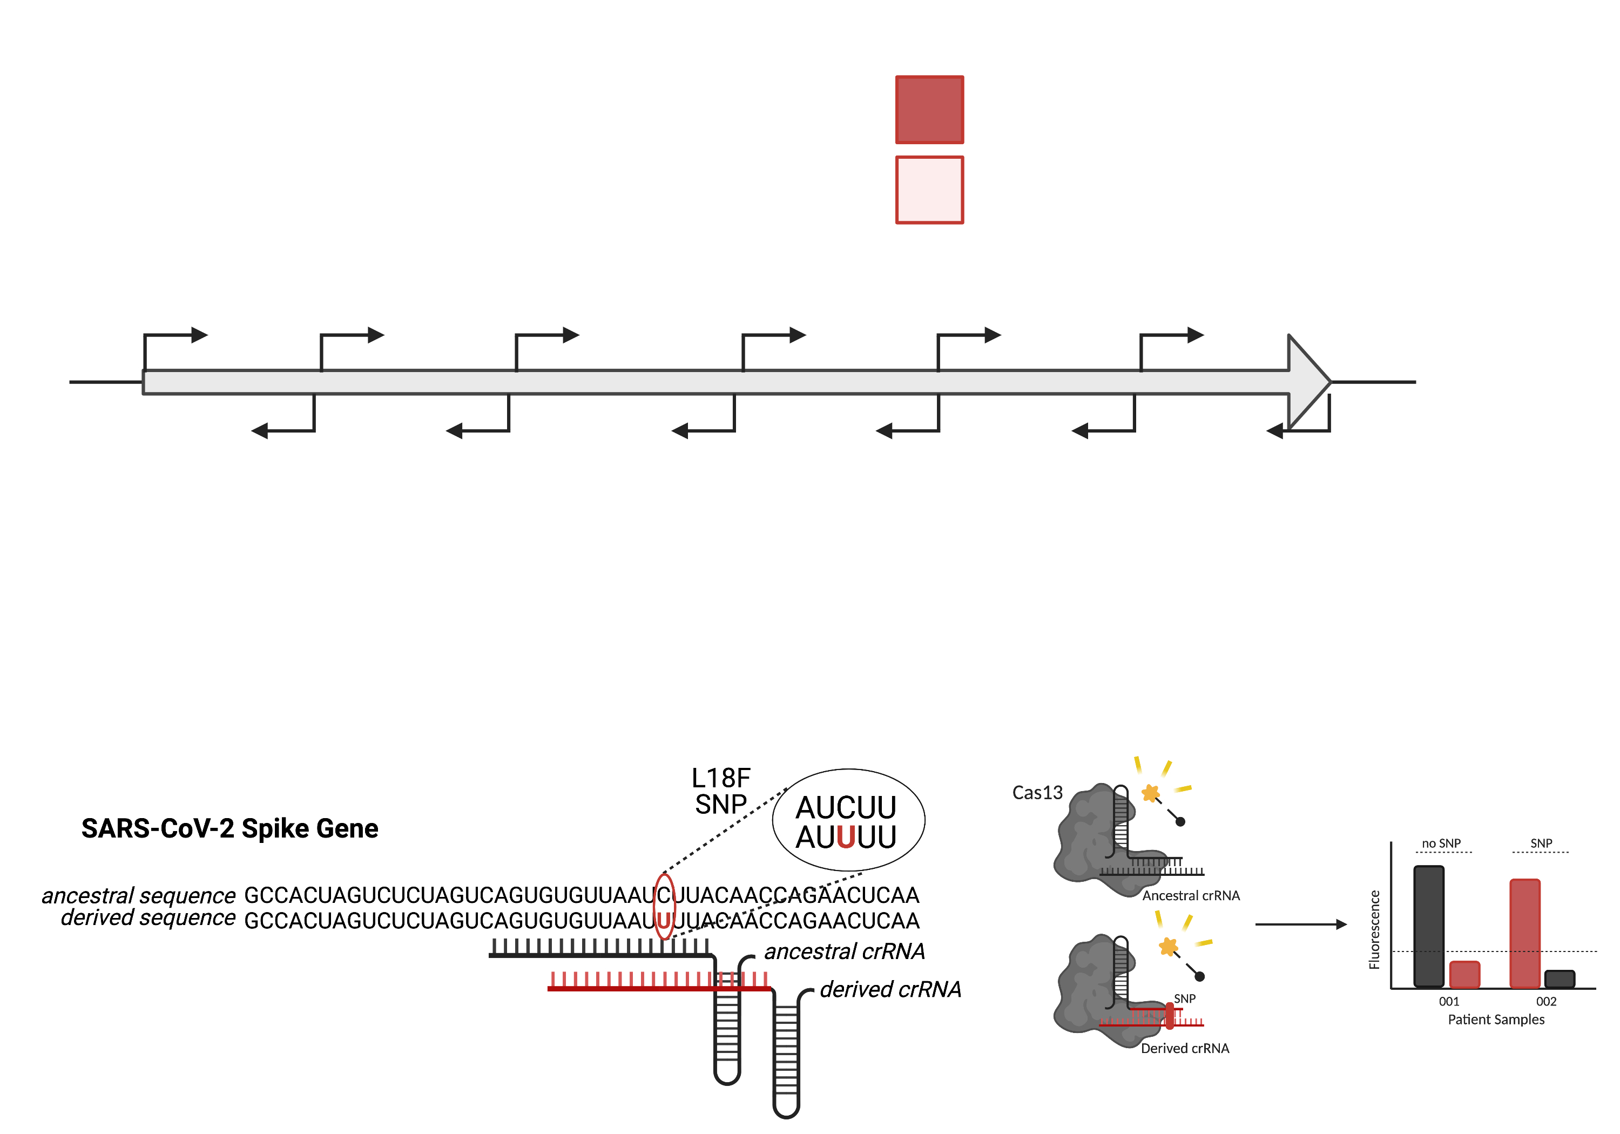
Variant testing with mCARMEN = crRNA pairs
Wild-type
Variant
Wild-type
Variant
Expected Results
Wild-type
Variant
Welch et al. medRxiv. 2021. 12.14.21265689; doi: https://doi.org/10.1101/2021.12.14.21267689

Slide 18
Variant testing with mCARMEN
Wild-type
Variant
Wild-type
Variant
Expected Results
Wild-type
Wild-type
Variant
Variant
Welch et al. medRxiv. 2021. 12.14.21265689; doi: https://doi.org/10.1101/2021.12.14.21267689

Slide 19
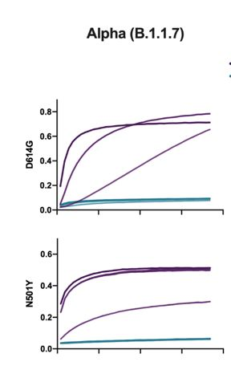
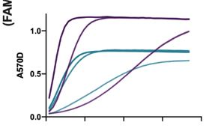
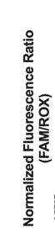
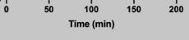
Variant Data Collected Over Time
Different crRNA pairs will have different kinetics, so it is important to look at the data as it progresses through time – pictures every 5 minutes for 3 hours. Analysis is time sensitive and concentration sensitive.
Purple = Variant genome
Teal = WT genome
Welch et al. medRxiv. 2021. 12.14.21265689; doi: https://doi.org/10.1101/2021.12.14.21267689

Slide 20
Bringing mCARMEN to CDC

Slide 21

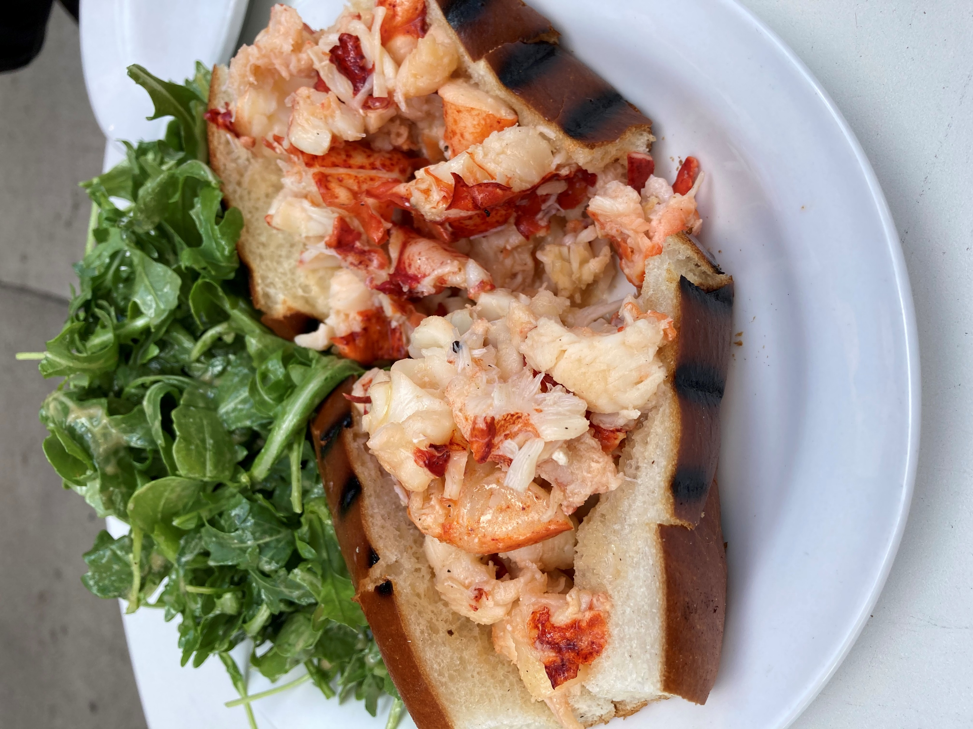


Deployment to Broad Institute – May 2021

Slide 22
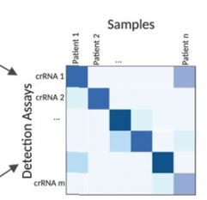
CDC Proof of Concept Experiment
NS3 SC2 Genomes
Heatmap analysis/blinded identification
Run mCARMEN

Slide 23
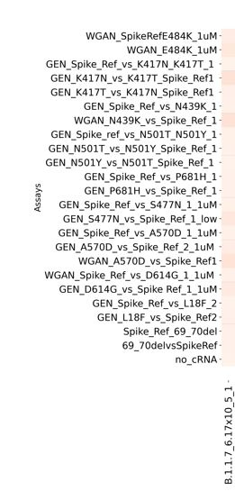
CDC Proof of Concept Experiment – Heatmap Analysis Examples
B.1.1.7
P.1
K417 - WT sequence
K417T
439N - WT sequence
439N - WT sequence
501Y
501Y
P681H
D614G
D614G
Del at 69 and 70
No Del at 69 and 70

Slide 24
CDC Proof of Concept Experiment – Heatmap Examples
B.1.617.2
E484 - WT sequence
K417 - WT sequence
439N - WT sequence
P681H
477S - WT sequence
D614G
No Del at 69 and 70

Slide 25
Advantages of CRISPR-Based Diagnostics
Nimble – can switch out assays without impacting performance of other assays on the chip – important during emergencies or in quickly evolving situations
In some cases, RT-PCR is not optimal
Capturing the diversity of a specific pathogen with one design (eg, Influenza H5)
Designs towards single nucleotide changes – sometimes this is difficult for RT-PCR
Machine-learning algorithms available for optimal design of targets (e.g. ADAPT = Activity informed Design with All-inclusive Patrolling of Targets = maximal predicted detection activity while taking into account viral diversity)
Portable versions continue to be optimized for in-field use

Slide 26
Some Next Steps
Continue optimization of in-house usage of CARMEN
CRISPR-based assays targeting common respiratory pathogens with a focus on influenza subtypes and substitutions relating to treatment-resistance
Bring SHINEv2 (Streamlined Highlighting of Infections to Navigate Epidemics) onboard – a Cas13-based nucleic acid detection that combines quick and ambient temperature sample processing and lyophilized reagents with a lateral flow readout = highly portable.

Slide 27
Acknowledgements
FluLIMS Transition
Jimma Liddell
FluLIMS team
Thank you to the Users of the system!
CARMEN at CDC
Malania Wilson
Jimma Liddell
Matt Keller
Bin Zhou’s lab for Titered SC2 viruses
Justin Lee’s lab for NS3 genomes
Pardis Sabeti lab – Broad Institute
Cameron Myhrvold lab - Princeton

